Slide 1


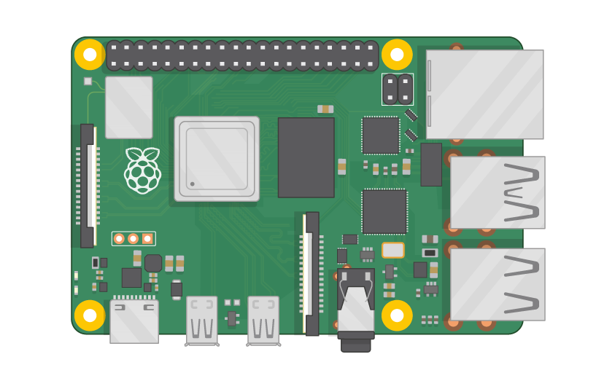
Raspberry Pi Master Class Day-5
RFID based Authentication system UART & SPI

Slide 2
Table of Contents
01
02
03
04
Radio Frequency
Serial Communication
Overview
Overview
Authentication System
Discussion & Q&A
RF Reader & Card
Interractive session

Slide 3
PREREQUISITES FOR THIS COURSE
Raspberry Pi 3 Model b/B+
16 GB SanDisk class 10 SD Card
Card reader
Laptop with Internet
Power Adapter – 5V 2Amps
USB B-Type Cable
RF Reader & Card

Slide 4
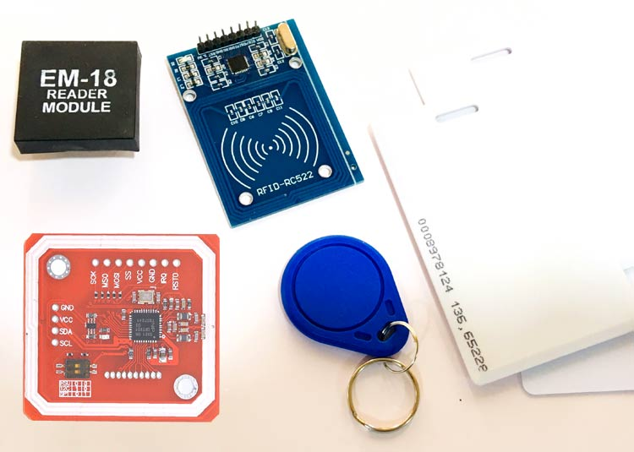
Radio Frequency Identification
The device is based on the Radio frequency signals.
The RFID systems consists of RFID Reader and a tag which is normally used in identification and tracking of objects.
It is a device which consists of an antenna, transceiver and a decoder.
Radio-Frequency Identification (RFID) is the use of radio waves to read and capture information stored on a tag attached to an object

Slide 5
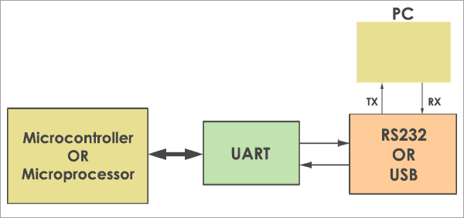
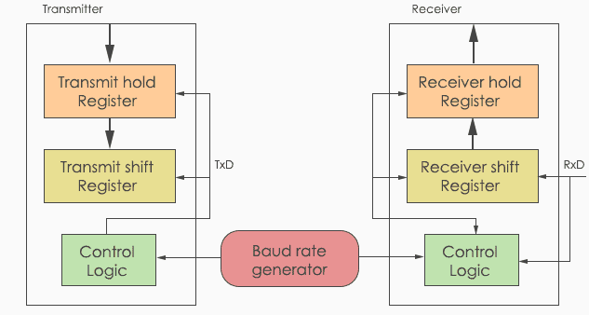
Serial Communication - UART
UART (Universal Asynchronous Transmitter Receiver), this is the most common protocol used for full-duplex serial communication.
It is a single LSI (large scale integration) chip designed to perform asynchronous communication.
This device sends and receives data from one system to another system.

Slide 6
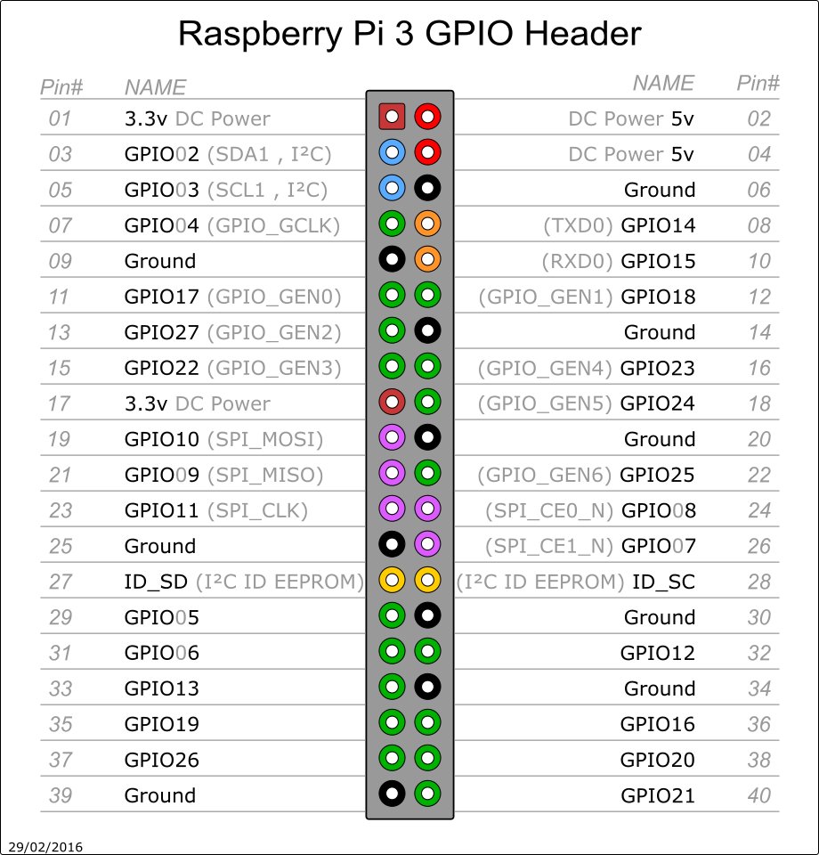
Pin Out of RPi3

Slide 7
Configuring Rpi for Serial…
Enabling Serial from Raspi-config
Login Shell – No
Serial Port - Yes
reboot

Slide 8
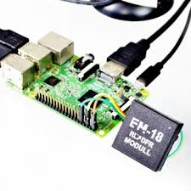
EM-18 RF Reader with Rpi…

Slide 9
Configuring Rpi for SPI & MFRC522…
Enabling SPI from Raspi-config
reboot
SPIDEV - sudo pip3 install spidev
mfrc522- sudo pip3 install mfrc522

Slide 10
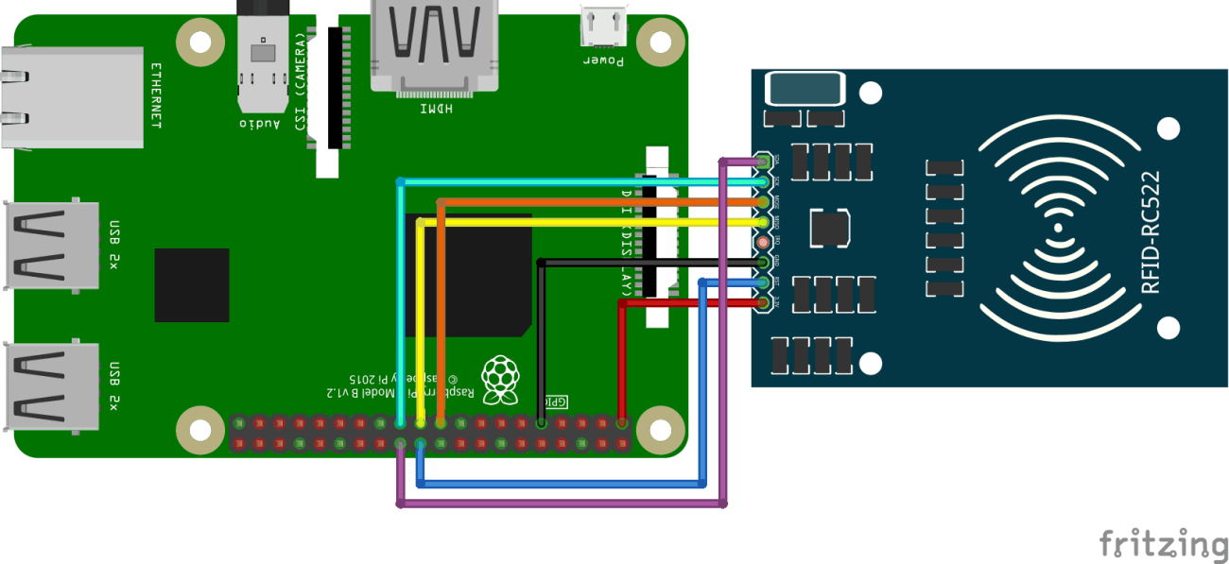
Rc522 RFID with RPi
SDA -------->GPIO8.
SCK -------->GPIO11.
MOSI -------->GPIO10.
MISO -------->GPIO9.
GND -------->Gnd.
RST -------->GPIO25.
3.3v -------->3.3v.

Slide 11

Q5 – Discussion
700 miles an hour | 1126Km/hour
1., the pods carrying passengers travel through tubes or tunnels from which most of the air has been removed to reduce friction
2. Rather than using wheels like a train or car, the pods are designed to float on air skis, using the same basic idea as an air hockey table, or use magnetic levitation to reduce friction.
HyperLoop

Slide 12

Q6 – Discussion
Who is Killer Voltage or Current ?

Slide 13
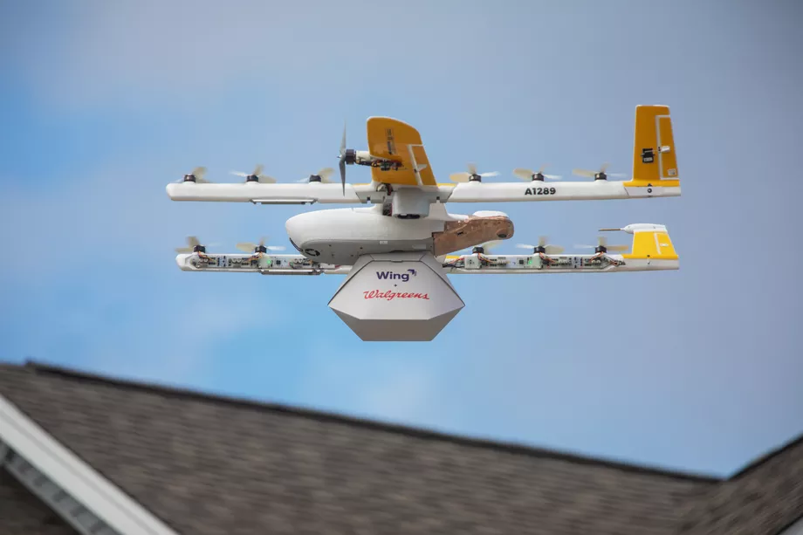
Google’s Wing warns new drone laws ‘may have unintended consequences’ for privacy
Tech News - 5
Dec - 2020
This past week, the US government made the single biggest, most impactful set of changes to drone law we’ve yet seen — ruling that almost every drone in US airspace will need to broadcast their locations, as well as the location of their pilots, in order to “address safety, national security, and law enforcement concerns regarding the further integration of these aircraft into the airspace of the United States”.
Google (technically, Alphabet) isn’t too happy about those new rules, as it turns out.

Slide 14

Thanks!
learn.pantechsolutions.net
www.pantechsolutions.net
“Don’t take rest after ur 1st victory. Coz if u fail in 2nd, more lips are waiting to say that ur 1st victory was just luck”
- APJ Abdul kalam

